Slide 1
Application 19.01
Open Pit Mining
Network Optimization Applications 19.01 by 成大資管所

Slide 2
Introduce
Reference:
  Optimum Open Pit Mine Production Scheduling. [Johnson,Thys B. 1968]
Problem type :
  Minimum cut problem
  Maximum flow problem
Master problem :
  Discuss how to govern the mining system.
Network Optimization Applications 19.01 by 成大資管所

Slide 3
Related Words
Open pit mineral supply process in terms of three important phases:
Planning, implementation and production.
Traditional mining problem:
discuss the improvement of the developed technique and implement
Network Optimization Applications 19.01 by 成大資管所
Notes:
在planning階段是主要影響生產價值的關鍵
應該評估
Which part要採
When該採
How to mine

Slide 4
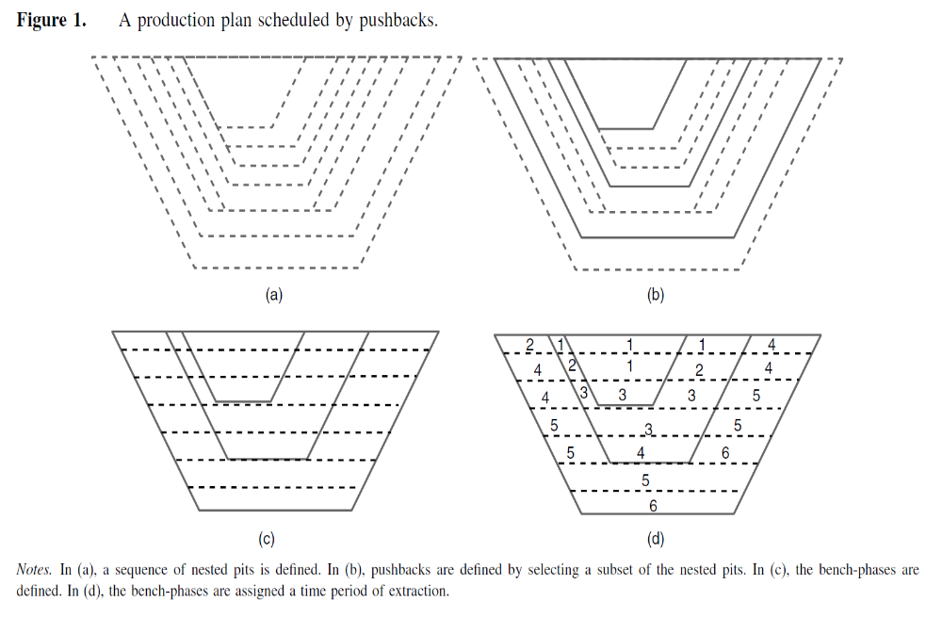
Network Optimization Applications 19.01 by 成大資管所

Slide 5
Johnson work(1)
Define [0-1] variables describing the amount and type of material mined from each block, as well as the method and time of extraction.
Consider the precedence constrains and a number of different capacity constrains, include
  (1)Hours available per type of equipment(每種設備的可用時間)
  (2)Waste handling capacity(浪費的效能)
  (3)Stockpiling capacity(儲存的效能)
  (4)Capacity of plants(效能計畫)
  (5)Blasting man-hours(爆破工時)
  (6)Lower and upper bounds on mining volumes(採礦的量)
  (due to legal constrains, plant-feed requirements, and marketability)
  (7)Volumetric ratio constrains for concentrator input(集中輸入的容積率限制)
Network Optimization Applications 19.01 by 成大資管所

Slide 6
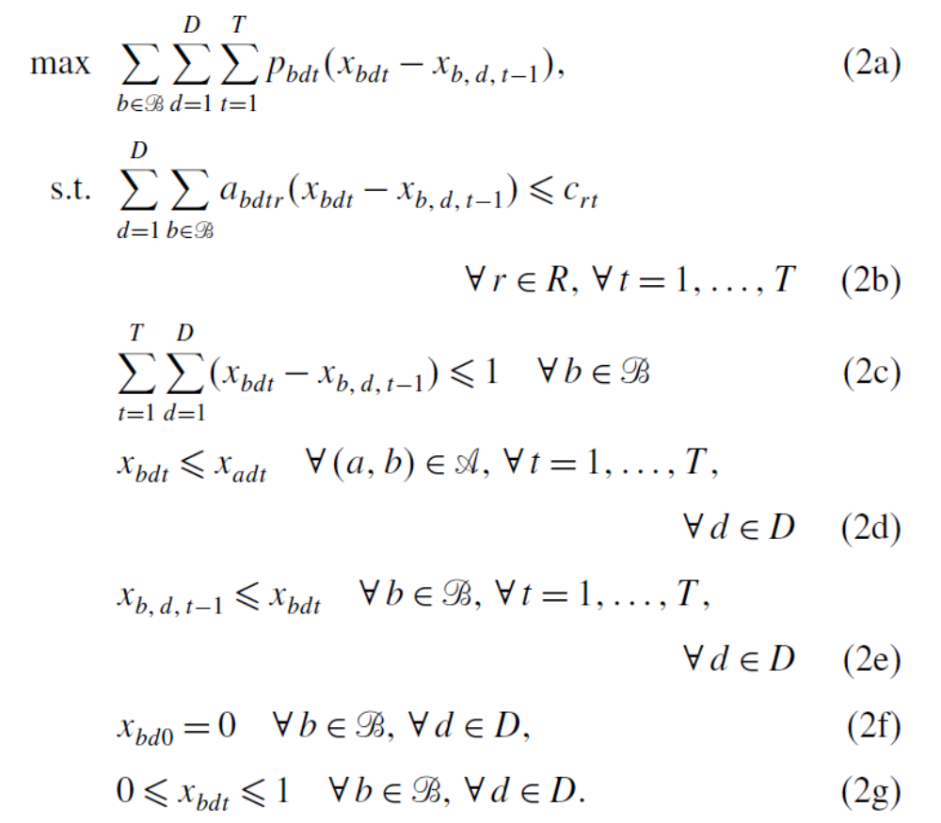
Small relative to other constraints
Network Optimization Applications 19.01 by 成大資管所

Slide 7
Johnson work(2)
Reduce the problem to solving T disjoint maximum closure problem.
Propose a Dantzig Wolfe decomposition
Developed a Lagrangian relaxation procedure and subgradient methods to tackle the problem(1986)
Network Optimization Applications 19.01 by 成大資管所

Slide 8
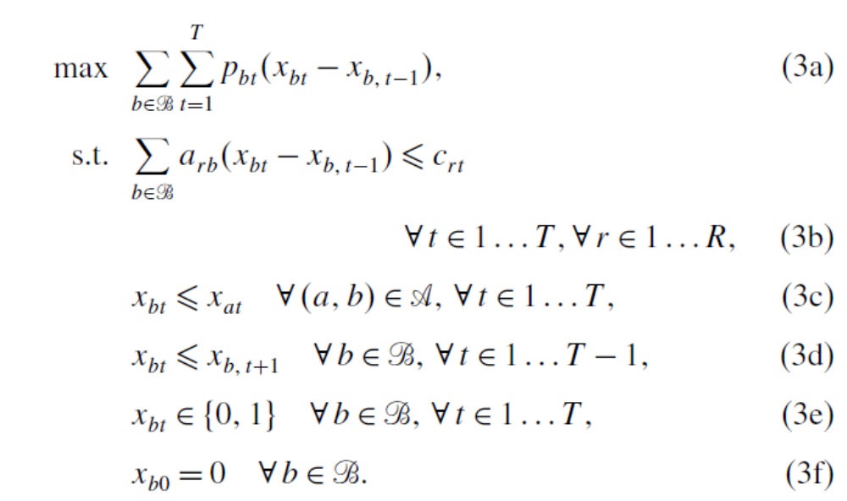
Network Optimization Applications 19.01 by 成大資管所

Slide 9
Solution
Solution procedure: Decomposition + Partitioning
Goal : Wish to identify the set of block that maximize the profit.
Restriction: (P722 fig19.3)
1. We can never remove the block until we have
removed every blocks that lies immediately above it.
2. The restriction on the “angle” of mining the blocks
impose similar to the precedence
Network Optimization Applications 19.01 by 成大資管所

Slide 10
Solution
Definition:
each block as a node , we must remove the block i
before the block j , include arc(i,j)
→i,j: block
→wi : the net profit obtained from removing the
block
→B: the contour of the block we want to remove
Network Optimization Applications 19.01 by 成大資管所

Slide 11
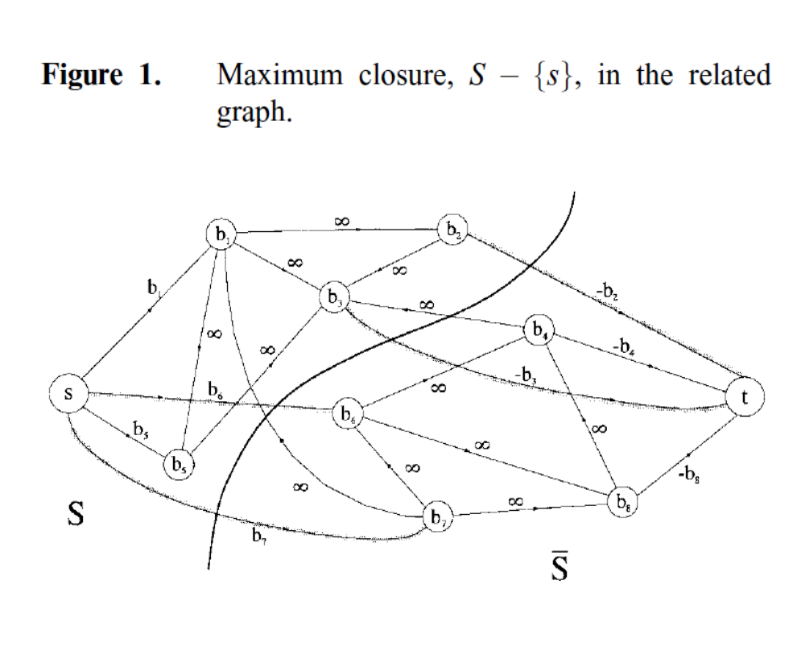

Network Optimization Applications 19.01 by 成大資管所

Slide 12
Reference
A new—old algorithm for minimum-cut and maximum-flow in closure graphs
  http://onlinelibrary.wiley.com/doi/10.1002/net.1012/abstract
A New Algorithm for the Open-Pit Mine Production
Scheduling Problem
  http://pubsonline.informs.org/doi/pdf/10.1287/opre.1120.1050
Network Optimization Applications 19.01 by 成大資管所

